Slide 1
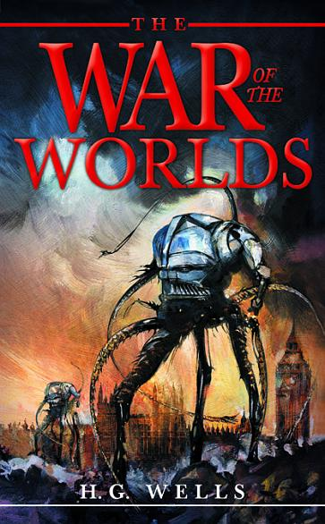
‘War of the Worlds’ by H.G. Wells
May 2020
Creative writing unit

Slide 2
Learning Intentions & Success Criteria
To develop your understanding of description, imagery and narrative voice in creative writing
To build your vocabulary
To use different media texts in my learning
To use your understanding in your own creative writing
I can identify description, imagery and narrative voice in the text
I have learnt new words and understand what they mean
I have successfully used written texts, film clips and spoken word to develop my learning
I can use sophisticated description in my own creative writing

Slide 3
‘The War of the Worlds’ Historical and cultural context -look up the underlined words and write down their definitions
1898 the British Empire was the most dominant colonial power on earth. London was its political centre, making it a natural starting point for an imagined alien invasion.
Towards the end of the 19th century a very real fear developed that the turn of the century would be the ‘end of the age’ and the apocalypse would begin.
There was also a fear of mass immigration due to colonialism.
HG Wells used his own experiences in the novel and explored fear of the unknown, paranoia and the possibility of the world ending. He also used the novel to explore his own misgivings about imperialism and explore how easily civilisation can break down when faced with a seemingly unbeatable adversary.

Slide 4
‘War of the Worlds’ by HG.Wells
H. G. Wells’, 1898 novel The War of the Worlds (about a devastating alien invasion on Earth) is often viewed as the best science fiction adventure novel of all time. It has been published continuously for over 100 years!
Actor and director Orson Welles brought back the frightening story for a 1938 radio broadcast. It was narrated by Welles as a real news bulletin. It led to widespread panic as listeners thought the Martian invasion was real. People abandoned their homes and fled the cities. Imagine how scared they must have been.
The War of the Worlds has been adapted dozens of times, most popularly by Steven Spielberg in a 2005 film starring Tom Cruise. But the book itself lives on in the imaginations of readers everywhere.

Slide 5
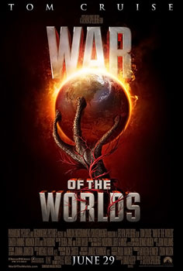
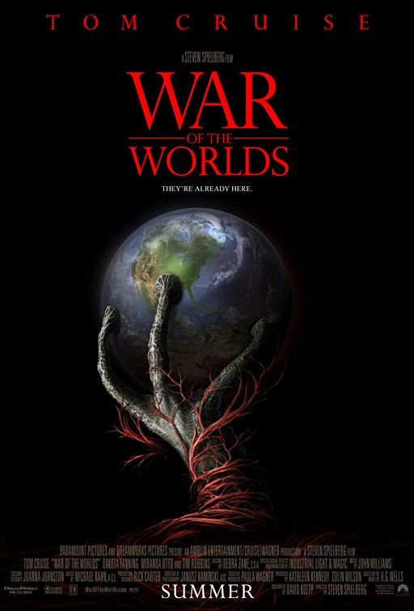
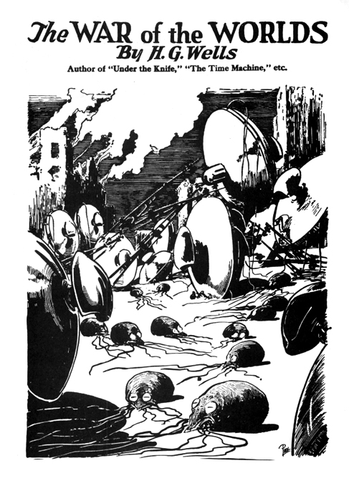
Research time!
Now you are in S3 we will ask you to research topics in your own time
Let’s start now
Before you move on, research more about ‘War of the Worlds’ and how H.G. Wells’ version made an impact and influence popular culture
Note down at least four interesting points
Tip: you could also ask the adults you live with if they know anything
This Photo by Unknown Author is licensed under CC BY-SA
This Photo by Unknown Author is licensed under CC BY-SA
This Photo by Unknown Author is licensed under CC BY-SA
This Photo by Unknown Author is licensed under CC BY-SA

Slide 6
You are going to read a chapter of the novel called ‘The Cylinder Opens’
Read ‘The Cylinder Opens’ on the next few slides
There is also a word document of the chapter in Files
Before reading note down what YOU THINK the chapter title suggests? What may have happened? What is going to happen?
Whilst reading imagine that you do not live in 2020 when alien invasion films may be exciting to watch but we do not view them as reality
Imagine you live in a time where:
The science fiction genre is not even a genre yet!
Modern technology does not exist
Man has not landed on the moon

Slide 7
‘The Cylinder Opens’ Remember always look up any words you do not understand
1
The crowd swayed a little, and I elbowed my way through. Everyone seemed greatly excited. I heard a peculiar humming sounds from the pit.
“I say!” said Oglivy;”help keep these idiots back. We don’t know what’s in the confounded thing, you know!”
I saw a young man, a shop assistant in Woking I believe he was, standing on the cylinder and trying to scramble out of the hole again. The crowd had pushed him in.
The end of the cylinder was being screwed out from within. Nearly two feet of shining screw projected. Somebody blundered against me, and I narrowly missed being pitched on to the top of the screw. I turned, and as I did so the screw must have come out, for the lid of the cylinder fell upon the gravel with a ringing concussion. I stuck my elbow into the person behind me, and turned my head towards the Thing again. For a moment that circular cavity seemed perfectly black. I had the sunset in my eyes.

Slide 8
2
I think everyone expected to see a man emerge — possibly something a little unlike us terrestrial men, but in all essentials a man. I know I did. But, looking, I presently saw something stirring within the shadow: greyish billowy movements, one above another, and then two luminous discs - like eyes. Then something resembling a little grey snake, about the thickness of a walking-stick, coiled up out of the writhing middle, and wriggled in the air towards me — and then another.
A sudden chill came over me. There was a loud shriek from a woman behind. I half turned, keeping my eyes fixed upon the cylinder still, from which other tentacles were now projecting, and began pushing my way back from the edge of the pit. I saw astonishment giving place to horror on the faces of the people about me. I heard inarticulate exclamations on all sides. There was a general movement backwards. I saw the shopman struggling still on the edge of the pit. I found myself alone, and saw the people on the other side of the pit running off... I looked again at the cylinder, and ungovernable terror gripped me. I stood petrified and staring.

Slide 9
3
A big greyish rounded bulk, the size, perhaps, of a bear, was rising slowly and painfully out of the cylinder. As it bulged up and caught the light, it glistened like wet leather.
Two large dark-coloured eyes were regarding me steadfastly. The mass that framed them, the head of the thing, was rounded, and had, one might say, a face. There was a mouth under the eyes, the lipless brim of which quivered and panted, and dropped saliva. The whole creature heaved and pulsated convulsively. A lank tentacular appendage gripped the edge of the cylinder, another swayed in the air.
Those who have never seen a living Martian can scarcely imagine the strange horror of its appearance. The peculiar V-shaped mouth with its pointed upper lip, the absence of brow ridges, the absence of a chin beneath the wedge-like lower lip, the incessant quivering of this mouth, the Gorgon groups of tentacles, the tumultuous breathing of the lungs in a strange atmosphere, the evident heaviness and painfulness of movement due to the greater gravitational energy of the earth – above all, the extraordinary intensity of the immense eyes - were at once, vital, intense, inhuman, crippled and monstrous. There was something fungoid in the oily brown skin, something in the clumsy deliberation of the tedious movements unspeakably nasty. Even at this first encounter, this first glimpse, I was overcome with disgust and dread.

Slide 10
4
Suddenly the monster vanished. It had toppled over the brim of the cylinder and fallen into the pit, with a thud like the fall of a great mass of leather. I heard it give a peculiar thick cry, and forthwith another of these creatures appeared darkly in the deep shadow of the aperture.
I turned and, running madly, made for the first group of trees, perhaps a hundred yards away; but I ran slantingly and stumbling, for I could not avert my face from these things.
There, among some young pine trees and furze bushes, I stopped, panting, and waited further developments. The common round the sand pits was dotted with people, standing like myself in a half-fascinated terror, staring at these creatures, or rather at the heaped gravel at the edge of the pit in which they lay. And then, with a renewed horror, I saw a round, black object bobbing up and down on the edge of the pit. It was the head of the shopman who had fallen in, but showing as a little black object against the hot western sun. Now he got his shoulder and knee up, and again he seemed to slip back until only his head was visible. Suddenly he vanished, and I could have fancied a faint shriek had reached me. I had a momentary impulse to go back and help him that my fears overruled.

Slide 11
5
Everything was then quite invisible, hidden by the deep pit and the heap of sand that the fall of the cylinder had made. Anyone coming along the road from Chobham or Woking would have been amazed at the sight—a dwindling multitude of perhaps a hundred people or more standing in a great irregular circle, in ditches, behind bushes, behind gates and hedges, saying little to one another and that in short, excited shouts, and staring, staring hard at a few heaps of sand. The barrow of ginger beer stood, a queer derelict, black against the burning sky, and in the sand pits was a row of deserted vehicles with their horses feeding out of nosebags or pawing the ground.
End of chapter.

Slide 12
Look at description slide 4 or the underlined section of the Word doc
H.G. Wells has used a fantastic selection of descriptive and emotive language
e.g. ‘the Gorgon groups of tentacles’ (Look the word Gorgon up to understand the image here. Fans of Stranger Things may recognise the word)
TASK - Make a list of all the descriptions of the Martian in the underlined section – aim to write down at least TEN (there are more than TEN)
If working on a screen you could highlight them
If on paper, you can make bullet points
Can you find an example of a simile?
Check your list against the answer sheet in Files

Slide 13
Identifying reactions, emotions and feeling TASK
Now you have identified what the Martian looks like, you now need to focus on how the narrator and the crowds react to the situation. H.G. Wells shows us with his choice of description rather than simply telling us.
Examples
‘A sudden chill came over me’ – this suggests us that the narrator is unnerved, terrified, unsure and scared. The word ‘chill’ links to the idea of coldness and in light of the situation the narrator could be so scared he is frozen to the spot.
‘loud shriek’ – this suggests that the woman was so taken aback by the sight that she screamed. Screaming is linked with fear.
Task – identify two other ways H.G.Wells shows us the way characters are reacting to the scene. Quote from the passage and explain what it tells us

Slide 14
First person Creative Writing Task
In the passage, a narrator is telling the story from a first person viewpoint This means everything that happens is described through his eyes.
-'I saw a young man ... I narrowly missed being ...“
TASK: You are going to write a description of this same strange event through another person's eyes - that of the young male shop assistant who was actually standing on the cylinder when it opened.
Remember to:
Include the sequence of events from the young man's point of view
Describe the physical and emotional effect the events would have on the young man
Describe the scene (and the young man's feelings) from a first person viewpoint -
write as though you are the young man, using ‘ I ...’
Tips on the next 3 slides

Slide 15
How to complete the task
Type it into the assignment set up by your teacher in Teams
Email it typed directly to your teacher
Complete it as part of the answers booklet and submit it to your teacher
It must be at least 10 - 15 sentences long and you should aim to go into as much detail as possible.

Slide 16
Show don’t tell reminder
When describing what the shop assistant can see avoid simply telling the reader
E.g. ‘I saw an alien and I felt scared’ – this is BORING!
Show the reader
E.g. ‘It felt as if my eyes were frozen wide open. My heart was racing, as what was staring back at me was certainly not human.’
Use your vocabulary to paint a picture with your words. Keep that in mind whilst writing. Make your description exciting. Draw the reader in and help them experience something through your eyes.

Slide 17
Creative writing tips
Look at your list of ways the Martian is described
Now try to explore how you could add to these descriptions
This is your creative writing so go big and describe something that is fantastical, unbelievable and heart-stoppingly mesmerising
Why not revisit the detail in Bradbury’s description of the T-Rex in ‘A Sound of Thunder’? There is some great description there to inspire you too
Remember to use
Similes – comparison using ‘like’ or ‘as’
Metaphors – direct comparison
Personification – giving something a human attribute

Slide 18
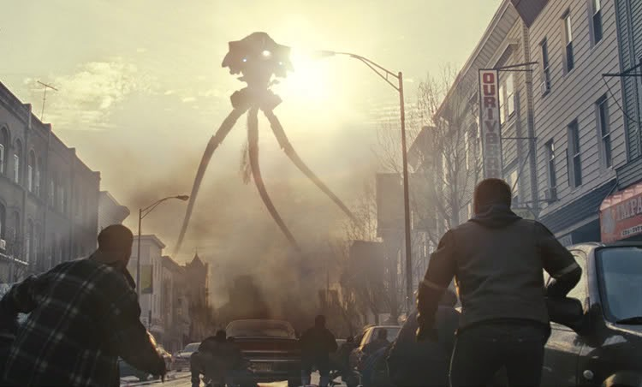
War of the Worlds Movie clip https://www.youtube.com/watch?v=DtM3UTktVWI
How does the first appearance of the Martians in the film, differ from the extract The Cylinder opens?
How has the director made this scene frightening?
Write down your thoughts – trust your instincts here
On the next slide you will read H.G.Wells’ description of the Tripods – there is a Word document version too

Slide 19
This is how H.G.Wells describes the Tripods later in the novel
And this Thing I saw! How can I describe it? A monstrous tripod, higher than many houses, striding over the young pine trees, and smashing them aside in its career; a walking engine of glittering metal, striding now across the heather; articulate ropes of steel dangling from it, and the clattering tumult of its passage mingling with the riot of the thunder. A flash, and it came out vividly, heeling over one way with two feet in the air, to vanish and reappear almost instantly as it seemed, with the next flash, a hundred yards nearer. Can you imagine a milking stool tilted and bowled violently along the ground? That was the impression those instant flashes gave. But instead of a milking stool imagine it a great body of machinery on a tripod stand.
Then suddenly the trees in the pine wood ahead of me were parted, as brittle reeds are parted by a man thrusting through them; they were snapped off and driven headlong, and a second huge tripod appeared, rushing, as it seemed, headlong towards me. And I was galloping hard to meet it! At the sight of the second monster my nerve went altogether. Not stopping to look again, I wrenched the horse's head hard round to the right and in another moment the dog cart had heeled over upon the horse; the shafts smashed noisily, and I was flung sideways and fell heavily into a shallow pool of water.
I crawled out almost immediately, and crouched, my feet still in the water, under a clump of furze. The horse lay motionless (his neck was broken, poor brute!) and by the lightning flashes I saw the black bulk of the overturned dog cart and the silhouette of the wheel still spinning slowly. In another moment the colossal mechanism went striding by me, and passed uphill towards Pyrford.
Seen nearer, the Thing was incredibly strange, for it was no mere insensate machine driving on its way. Machine it was, with a ringing metallic pace, and long, flexible, glittering tentacles (one of which gripped a young pine tree) swinging and rattling about its strange body. It picked its road as it went striding along, and the brazen hood that surmounted it moved to and fro with the inevitable suggestion of a head looking about. Behind the main body was a huge mass of white metal like a gigantic fisherman's basket, and puffs of green smoke squirted out from the joints of the limbs as the monster swept by me. And in an instant it was gone.
So much I saw then, all vaguely for the flickering of the lightning, in blinding highlights and dense black shadows.

Slide 20
Description and Drawing task
Underline/note down the ways H.G.Wells describes the Tripods (no answer sheet for this one as you should be well practised after the Martian)
In Files there is a template for you to draw what you think the Tripods look like
You must use H.G. Wells’ description and label your drawing
This will show that you have used Wells’ descriptive imagery to create a picture in your mind
This is not Art and Design!

Slide 21
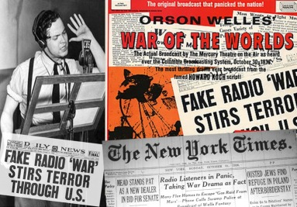
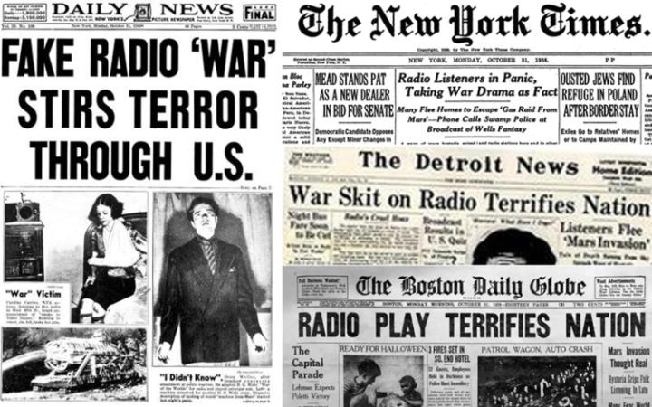
The Radio version that terrified America
On Hallowe'en night in 1938, Orson Welles broadcast War of the Worlds in America as a radio play. Welles cleverly changed the setting of The War of the Worlds story from London in the 1890s to contemporary America. The story was told through a series of realistic-sounding radio news bulletins.
It began with a studio announcement:
'We interrupt this programme to bring you a live, outside broadcast from Grovers Mill, New Jersey, where a strange cylinder has just landed.’
Listen an excerpt of the broadcast here
www.youtube.com/watch?v=Wf6omuz1MrM
Then, an actor playing the radio reporter said:
“A cylinder is unscrewing and a large, unearthly creature is wriggling out and...”
It wasn't long before thousands of people in all parts of the country started to panic. There were frantic telephone calls to radio stations and to the police. The streets were suddenly full of terrified people. One man was reported to have come home to find his wife clutching a bottle of poison. She was screaming/l would rather die this way than that!‘ When the hoax was revealed the next day, the name of Orson Welles became world-famous.

Slide 22
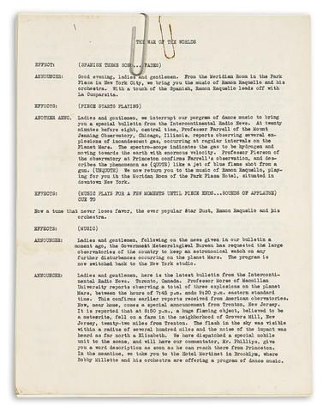
Radio Script task
You are going to write the opening to a radio script similar to that of Orson Welles. Set it in Dundee or any other city/town in 2020 and make the invasion sound realistic for a British audience.
You will need to think about the following if you are to convince a modern audience that a Martian invasion is actually taking place:
• what is to be said?
• who is to say it?
• will you use interviews, journalists' reports, or both?
Example on the next slide

Slide 23
Task success criteria Write two pages of A4 typed or handwritten
This is the opening of the radio show
set the scene
use at least three characters
When writing a script you should write the person’s name who is talking then a colon. Always put speech inside speech marks.
e.g.
Reporter: “It was alive I tell you, alive!”
Scientist: “The way it moved, writhing and pulling against gravity suggested this was not something we had ever experienced on this planet before.”

Slide 24
Example radio script
Reporter: ‘I got the call and drove to the scene as quickly as I could. What met me when I got there was the single most terrifying spectacle I have ever seen. Let me say I have seen plenty in my line of work.
The sea of spectators had been forced back by some sort of green mist pouring out of the bottom of the spinning metal. I had seen the swirling emerald fog as my car got closer but on closer inspection it appeared to twinkle as if full of glitter.
I couldn’t help but wonder why so many people were trying to get closer but again, a closer look revealed less a group of spectators, but rather a vacant army pushing forward like zombies.
Frantically I decided the scoop was less important than my safety. I turned swiftly and ran faster than ever before.
Orson Welles full radio script is available here:
https://casn.berkeley.edu/wp-content/uploads/resource_files/War_of_Worlds_script.pdf

Slide 25
‘The War of the Worlds’ -A musical adaptation
In 1978 composer and musician Jeff Wayne created a musical version of ‘ The War of the Worlds’
Full soundtrack here https://www.youtube.com/watch?v=6fnPn9Xr7fI
Listen to the first song at least – you may recognise it as it is used widely in popular culture
The album has sold over 15 million copies and has spawned:
A stage show
An arena tour
Computer games

Slide 26
Further reading
The full version of the H.G. Wells novel is available here
https://www.fourmilab.ch/etexts/www/warworlds/b1c2.html
This is a classic and a fantastic book to read at this point of your school journey.
You may even decide to read more of H.G. Wells!
Ever heard of ‘The Time Machine’?

