Slide 1
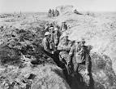
Western Front

Slide 2
Task 1
Colour code the trench diagram to show the different parts of the trench

Slide 3
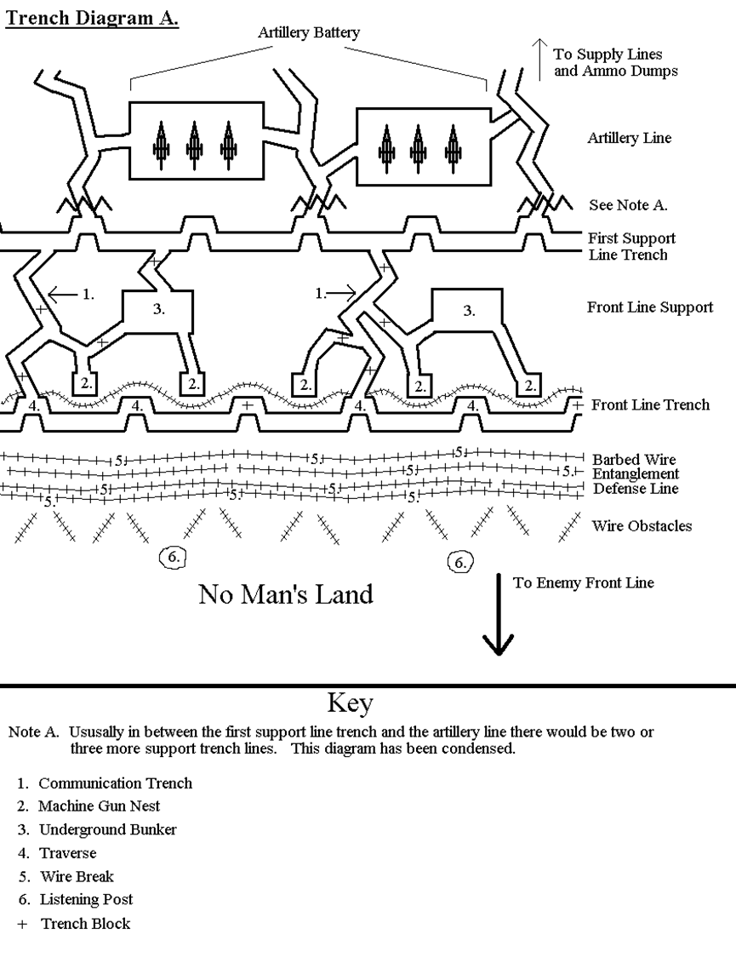

Slide 4
Self assessment
Listen to this WWI song
Write a song review to explain the following sc…
Three things the words are describing
Why did the soldiers make fun of the situation

