Slide 1

Using Digital Tools to Support Learners with Additional Support Needs.
Support for Pupils and Parents

Slide 2


Home Learners
This powerpoint is designed to be a guide for those using digital tools to work at home who may have additional support needs.
Here are a few examples of accessibility tools which are built into some of the digital tools you may be asked to use for school work.

Slide 3

In this Powerpoint…
How to find accessibility tools in the Windows ‘Ease of Access’ feature
How to find and use accessibility tools in Office 365
How to use accessibility tools in Google
How to use accessibility tools with iPad

Slide 4
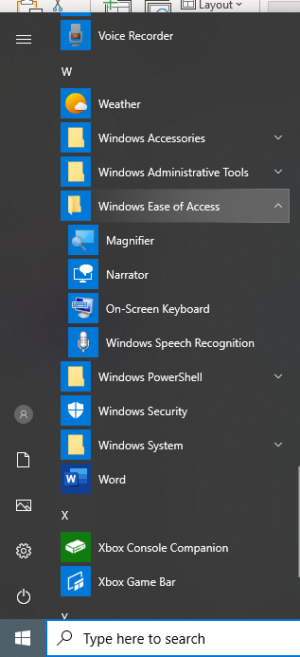
Windows Ease of Access
Magnifier - Zooms in on screen
Narrator – Text to Speech Reader
On Screen Keyboard – for using a mouse
Speech recognition – Speech to text

Slide 5
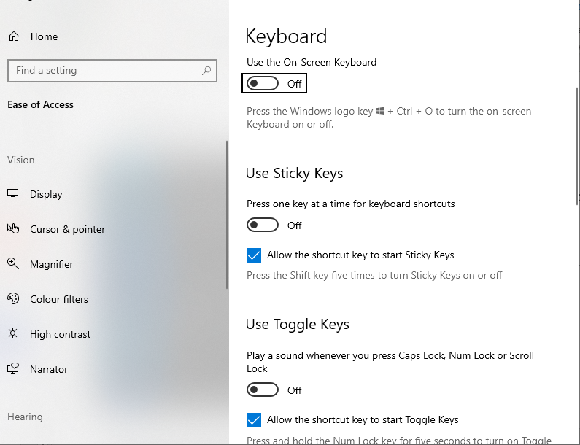
Windows Ease of Access - Settings
These shortcuts can be found in the start bar.
However, if you want to change the settings of these (e.g. accent of speech reader) search for Ease of Access which will take you to a settings bar.

Slide 6

Using Office 365 Tools
Every child is entitled to up to 15 downloads of Office 365. Here is a youtube video which shows you how to download this.
https://www.youtube.com/watch?v=OUSfzAlLFck
In the next few slides you will find information on the Accessibility features in Office 365. The next slide gives you a list of accessibility features and which programmes and applications have these features.

Slide 7
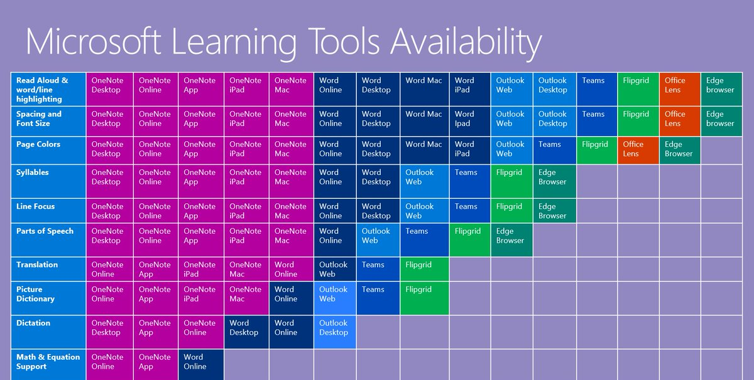

Slide 8
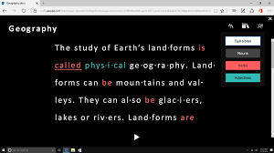
Immersive Reader
A free app which is included in Office 365 for Education. This was originally focused on helping those with dyslexia but can actually help all readers with a variety of additional reading needs. Along with overlays, IR has built in text to speech, language translators, grammar identifiers and boardmaker symbols to help earners understand the
This can be found in the view tab in word, but also in other
Please watch this video of the designers talking through the incredibly helpful immersive reader features - https://www.youtube.com/watch?v=wHJJCLV-DNg
Here is a video we have created to show pupils how to use the immersive feature along with other features in Microsoft Teams - https://www.youtube.com/watch?v=_fHMLQt4auw

Slide 9

Immersive Reader in the Assignment tools
Here is our guide to using the Assignments tool in Glow, which also shows how to use the Immersive Reader tool.
https://www.youtube.com/watch?v=_fHMLQt4auw

Slide 10

G-Suite In Glow
Accessibility for All– Louise Jones
https://docs.google.com/presentation/d/1Cipy9eZWHh96ehYVVh9S30bDulrd8P--TeqBdMoHIuk/edit#slide=id.g5c9566dbe4_3_0

Slide 11
Google G Suite
Here is the G Suite User guide to Accessibility - https://support.google.com/a/answer/1631886?hl=en
Here is a video guide to G Suite Accessibility tools - https://www.youtube.com/watch?v=INZNdJ9cdmk
How to innovate with Google Translate - https://www.youtube.com/watch?v=xwOzwktuRdQ

Slide 12

iPad Accessibility Tools

Slide 13
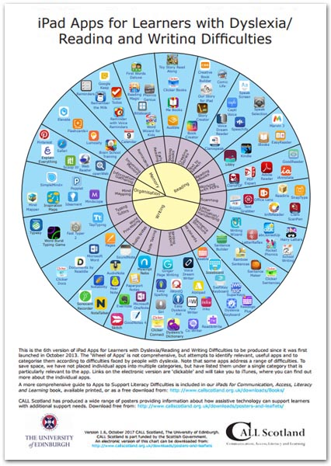
Call Scotland Resources
Call Scotland have created this useful helpsheet (along with many others) to help choose appropriate apps to help with reading and writing.
You can find the link to this, along with other helpsheets at –
https://www.callscotland.org.uk/downloads/posters-and-leaflets/ipad-apps-for-learners-with-dyslexia/

Slide 14
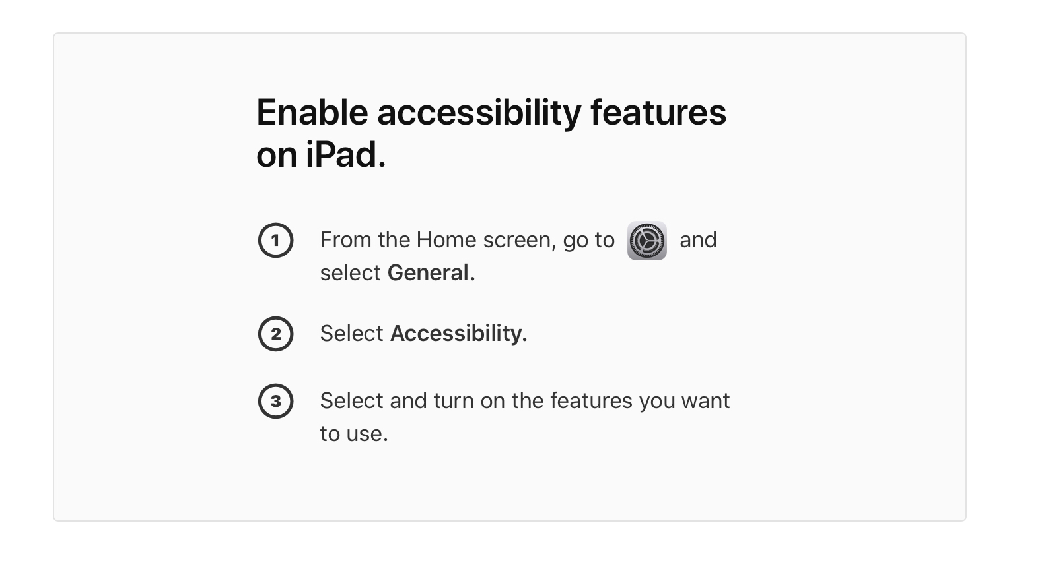
iPad accessibility features
https://www.apple.com/uk/accessibility/ipad/learning/

Slide 15
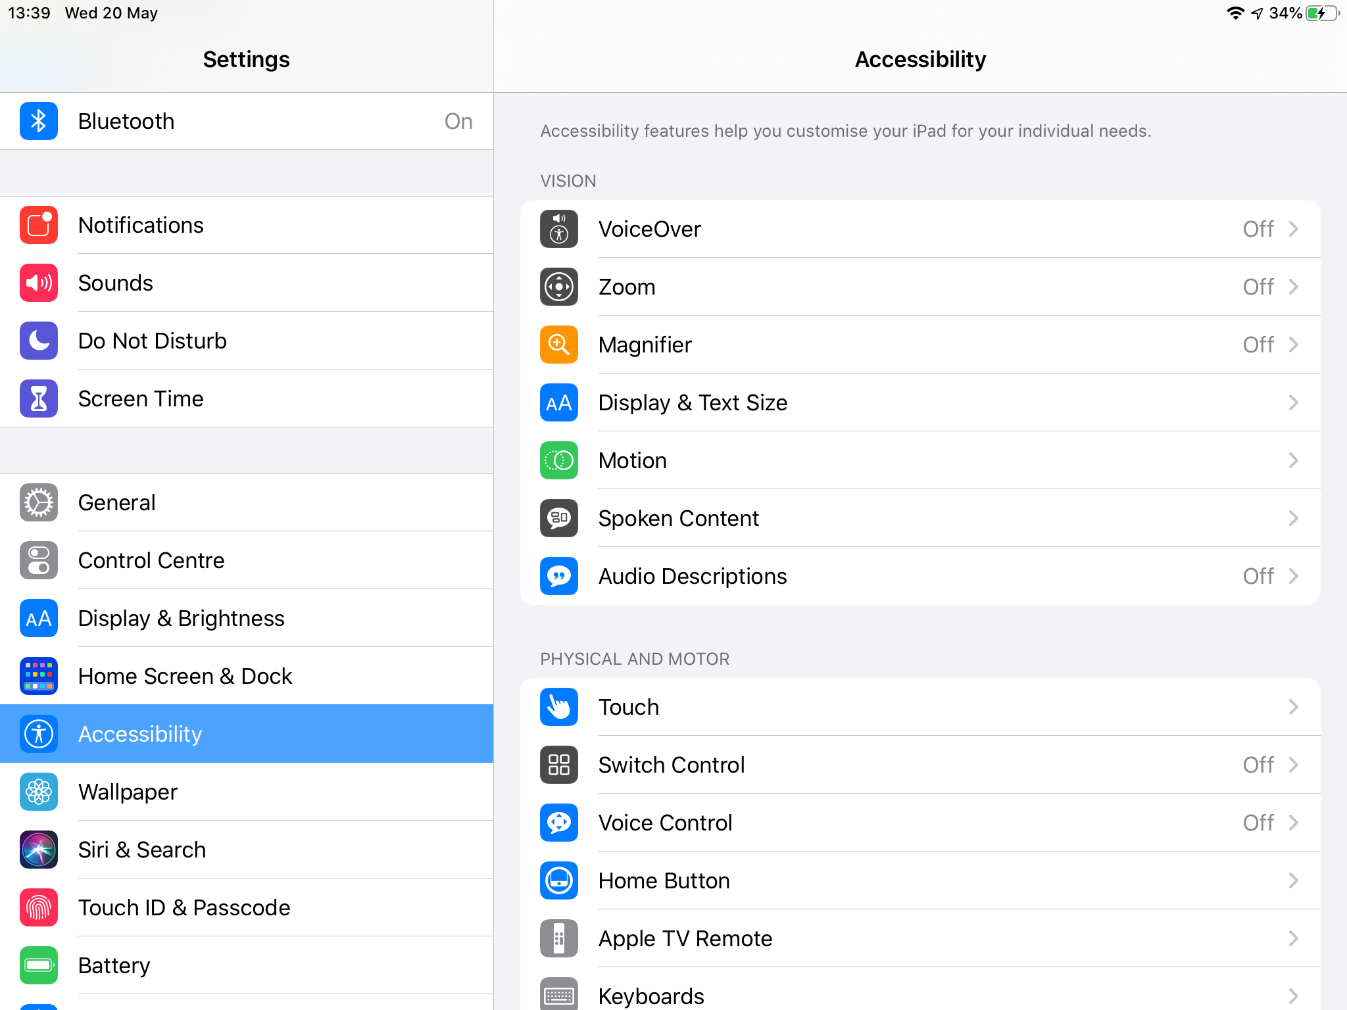
Accessibility can be found in general settings
As you can see there are many different ways in which iPads can support learners with Additional Support Needs.
Here is the accessibility menu

Slide 16
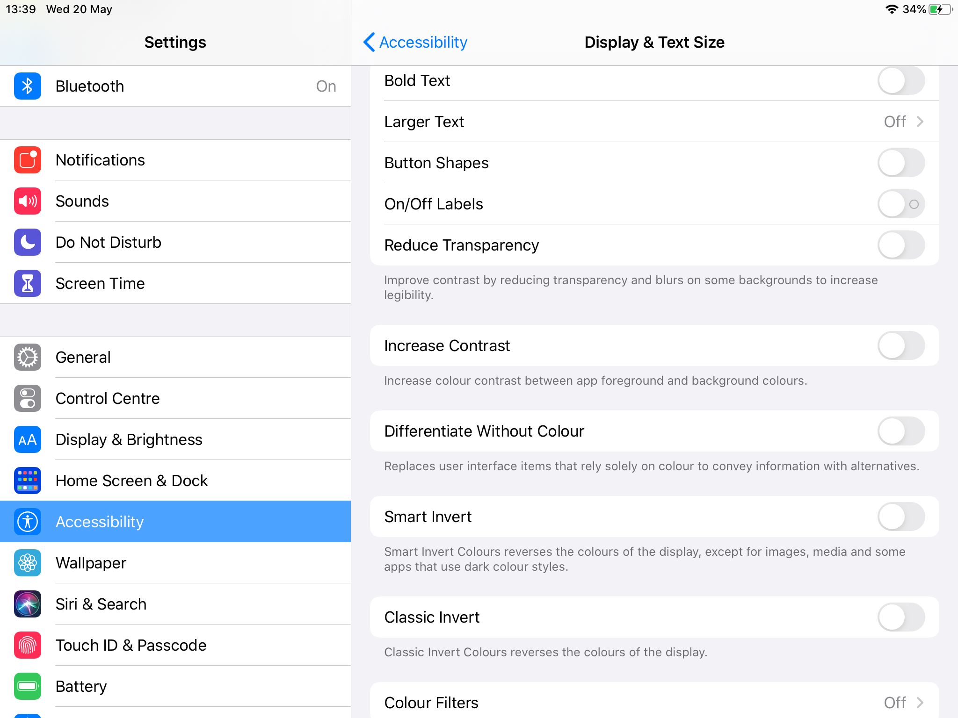
Display and Text Size
Learners with Visual Impairments may benefit from changing font sizes as well as the Maginify tool.

Slide 17
In Display and Text Size you can adjust any of the following…
Bold Text: Display the text in boldface characters.
Larger Text: Turn on Larger Accessibility Sizes, then adjust the text size using the Font Size slider. This setting adjusts to your preferred text size in apps that support Dynamic Type, such as Settings, Calendar, Contacts, Mail, Messages, and Notes.
Button Shapes: This setting underlines text you can tap.
On/Off Labels: This setting indicates switches turned on with “1” and switches turned off with “0”.
Reduce Transparency: This setting reduces the transparency and blurs on some backgrounds.
Increase Contrast: This setting improves the contrast and legibility by altering color and text styling.
Differentiate Without Color: This setting replaces user interface items that rely on color to convey information with alternatives.
Smart Invert or Classic Invert: Smart Invert Colors reverses the colors of the display, except for images, media, and some apps that use dark color styles.
Reduce White Point: This setting reduces the intensity of bright colors.
Auto-Brightness: This setting automatically adjusts the screen brightness for current light conditions using the built-in ambient light sensor.

Slide 18
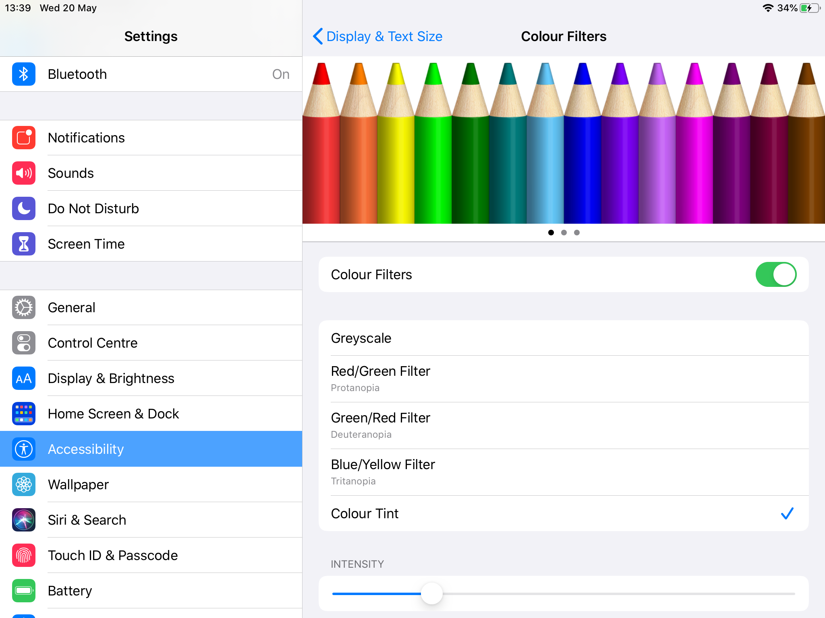
You can also change the colour filters
This may help learners who are colour blind
This can also be used as an overlay to help pupils with dyslexia.

Slide 19
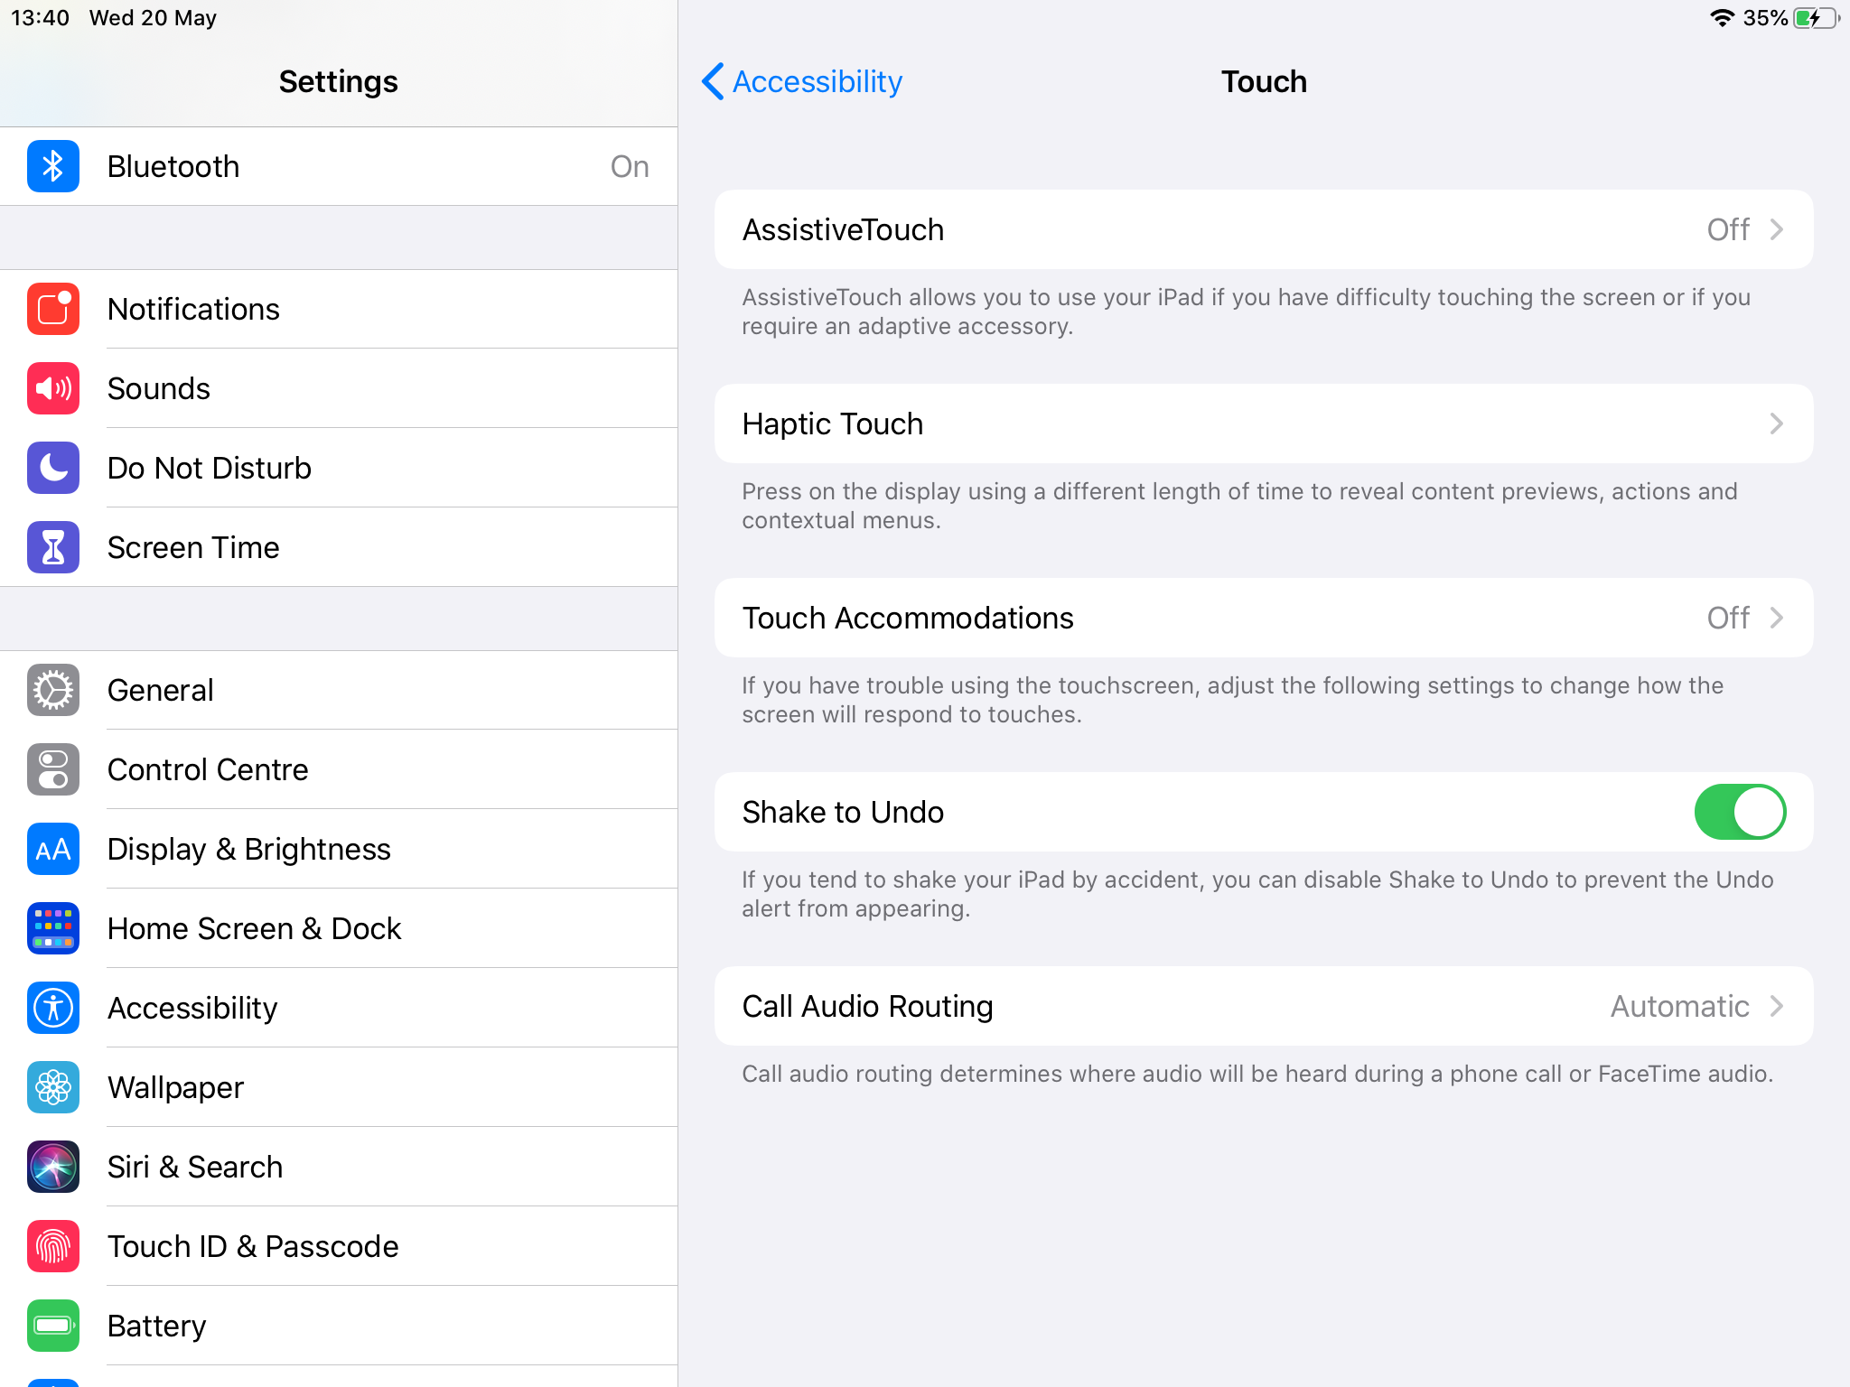
Touch
If learners have difficulty using the touchscreen or buttons, can they can change how iPad responds to their touch.

Slide 20
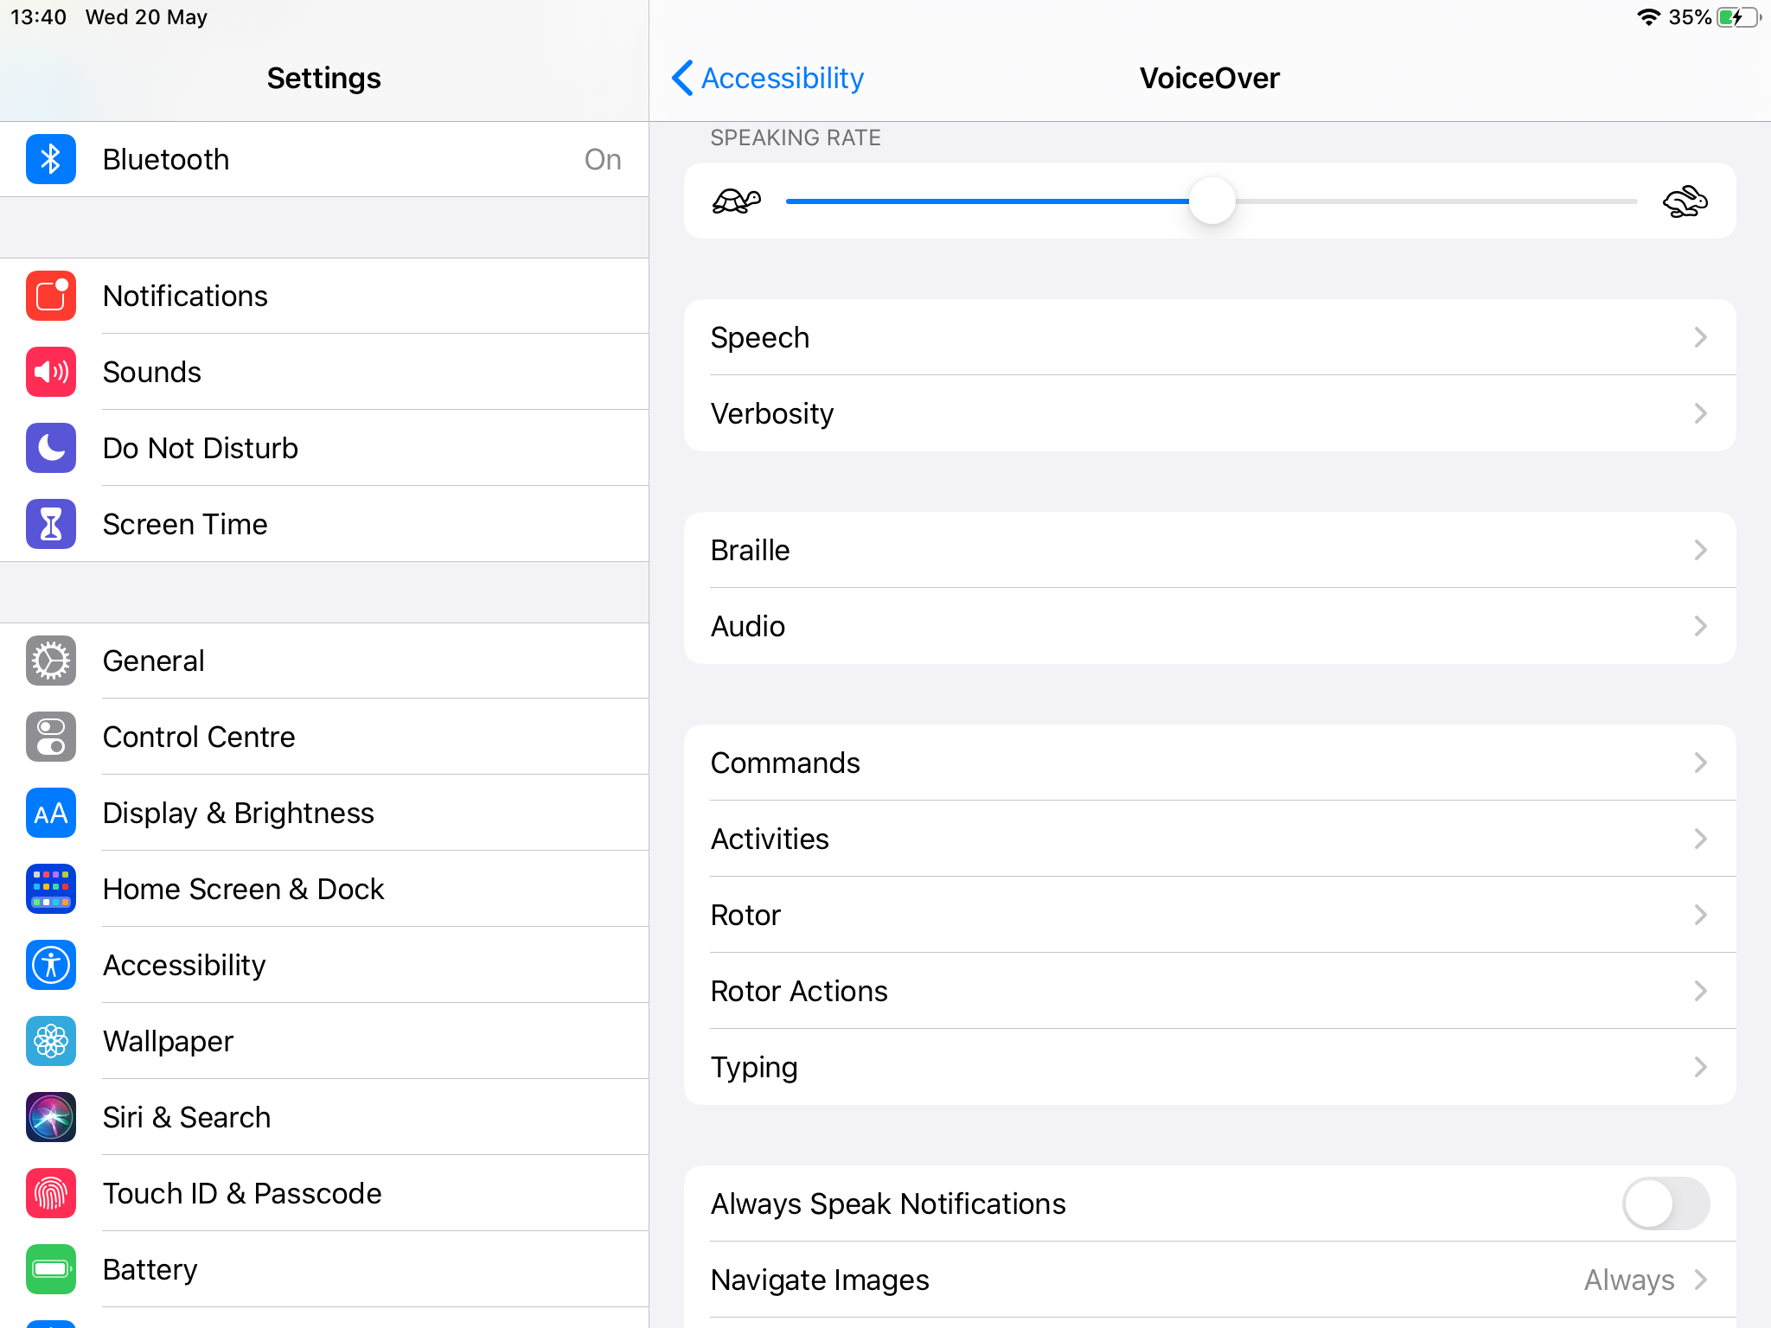
VoiceOver
With VoiceOver—a gesture-based screen reader—you can use iPad even if you don’t see the screen. VoiceOver gives audible descriptions of what’s on your screen—from battery level, to who’s calling, to which app your finger is on. You can also adjust the speaking rate and pitch to suit your needs.
When you touch the screen or drag your finger over it, VoiceOver speaks the name of the item your finger is on, including icons and text. To interact with the item, such as a button or link, or to navigate to another item, use VoiceOver gestures.
When you go to a new screen, VoiceOver plays a sound, then selects and speaks the name of the first item on the screen (typically in the top-left corner). VoiceOver tells you when the display changes to landscape or portrait orientation, when the screen becomes dimmed or locked, and what’s active on the Lock screen when you wake iPad.
Use this link to try using VoiceOver:
https://support.apple.com/en-gb/guide/ipad/ipad9a246898/ipados

Slide 21
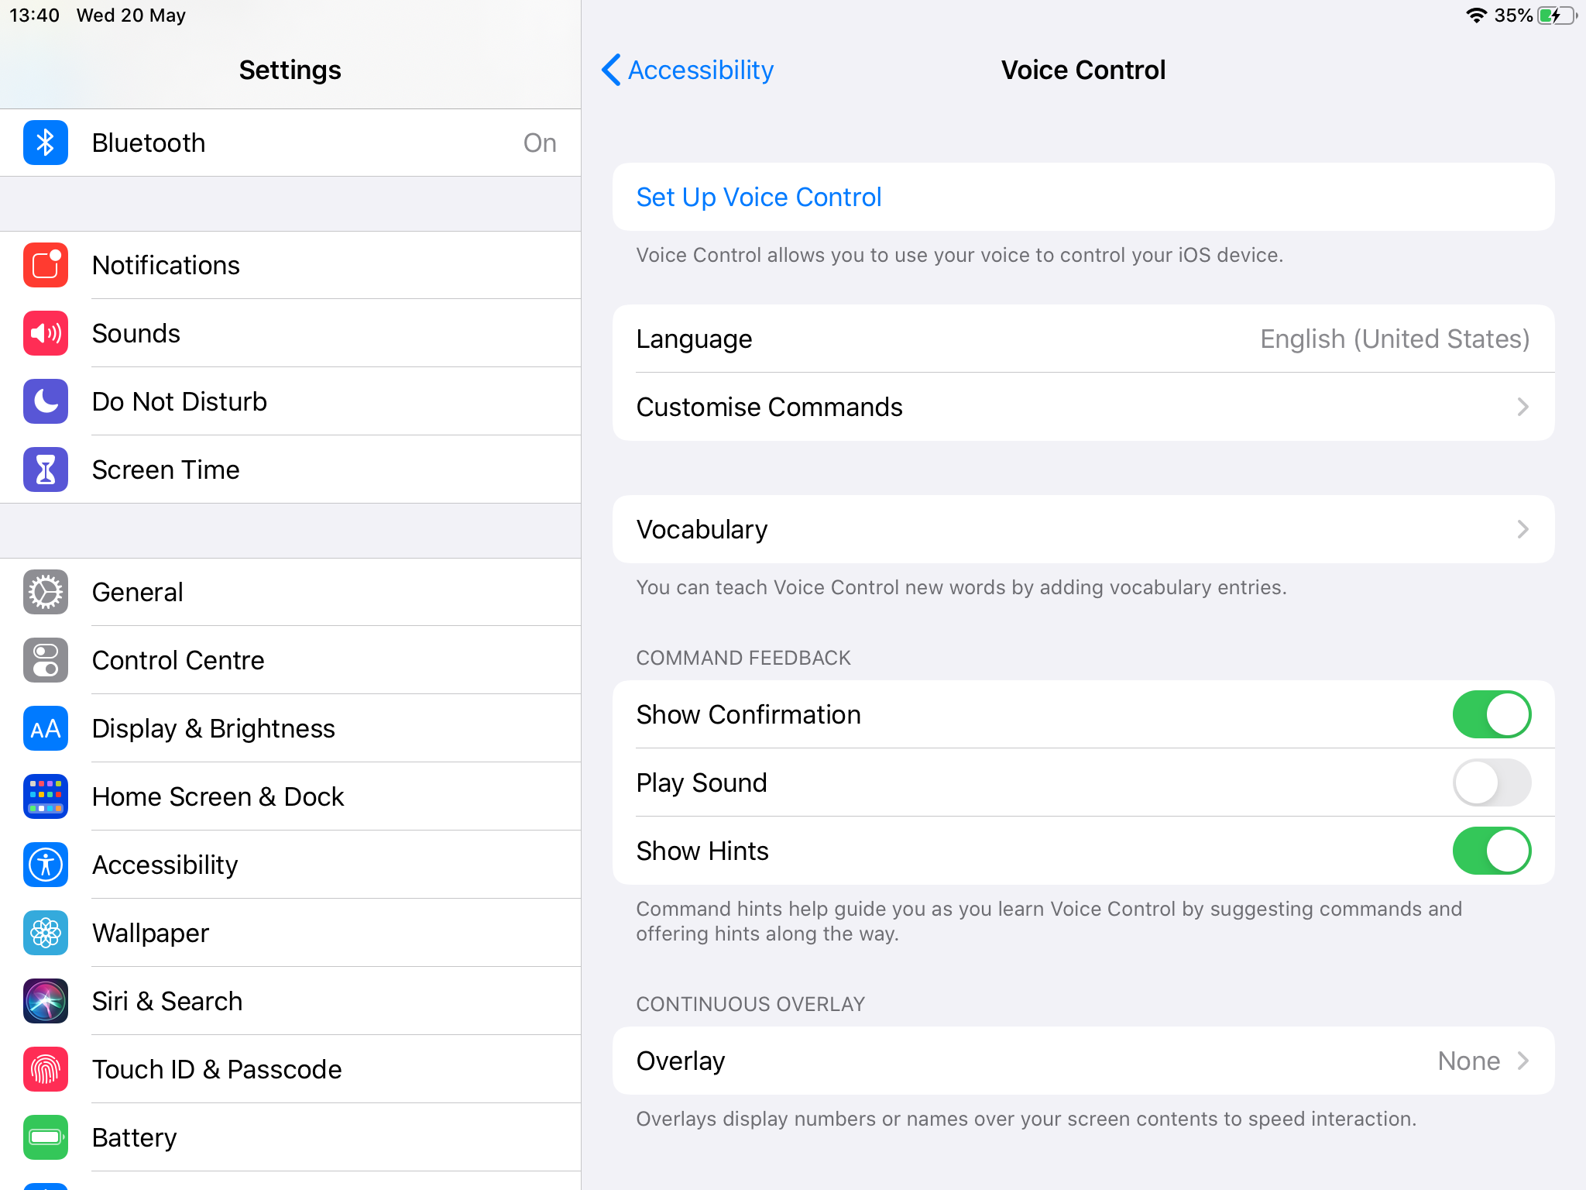
Voice Control
With voice control learners can navigate and interact with their device using their voice to tap, swipe, type and more.
When Voice Control is turned on, they can give commands such as “Swipe down” and the iPad will perform an action just as it would by touch.

Slide 22
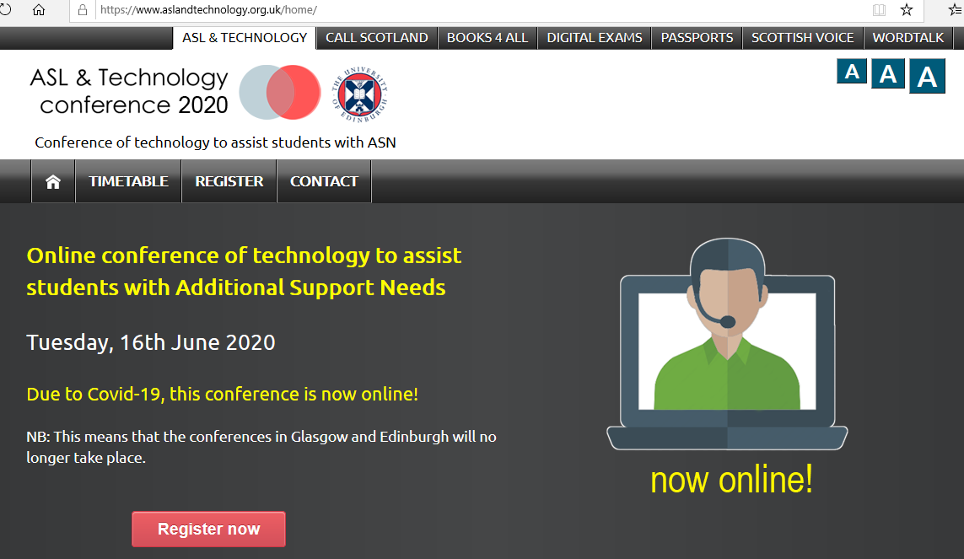
ASL and Technology Conference 2020
https://www.aslandtechnology.org.uk/home/

Slide 23
Call Scotland – Upcoming Webinars
Upcoming webinars
Using technology to support Storytelling for all learners
Wednesday, 27 May 2020 from 16:00-16:30 (UK time zone)
iPad apps to support learning and communication for those with autism
Wednesday, 24 June 2020 from 16:00-16:30 (UK time zone)
https://www.callscotland.org.uk/professional-learning/webinars/

