Slide 1
Time Travel Short Story Unit focusing on
‘A Sound of Thunder’by
Ray Bradbury
Aim: to explain how time travel impacts the plot, characters, and ending of a short story.

Slide 2
What is ‘Time Travel’?
What you think the term 'time travel' means?
Break it down into ‘time’ and ‘travel’
Look up both words to create a brilliant definition then write it down

Slide 3
Why would anyone want to ‘Time Travel’?
Imagine that you could travel backward OR forward in time...
THINK ABOUT exactly WHERE you would travel TO and WHEN exactly in time you would go.
Why not ask your family, parents and carers where they would travel to if they could.

Slide 4
Task: Reasons and purpose
When you have decided where and when you would travel to, write down your ideas
You could do this in bullet points or a mind map. If you can be colourful and creative!
Once this is complete add to your bullet points and mind map the reasons why, and what purpose your time travelling trip would have
You may find this a bit tricky so there are some ideas to help you on the next slide.

Slide 5
Some ideas for you. You need to provide the specifics though.
For some of the ideas provided you should do some online research. Or think of some of the texts we’ve read in class and the historical context.
Visit someone you love
An important event
To change the course of history (this is a biggie)
To see something from the past you have read about
To meet a historical figure
To stop a disaster
Revenge
To change a mistake you have made
To save the planet
To make sure two people do not meet
To invent something

Slide 6
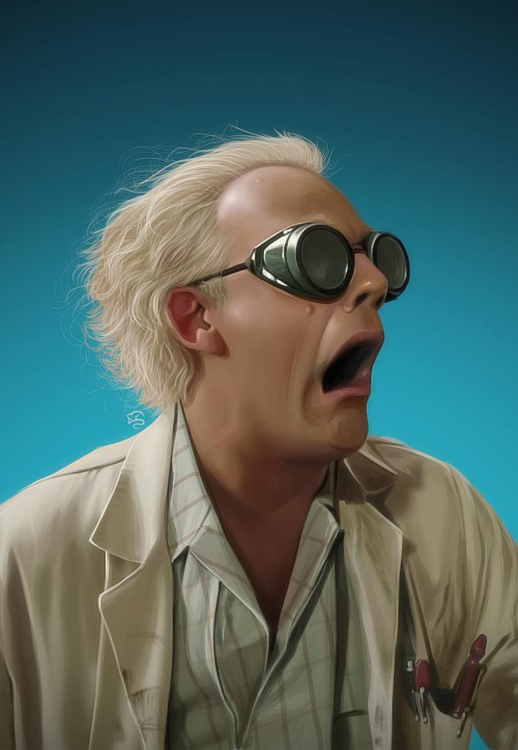
Now try to use your ideas and write a short diary entry about your plan to ‘time travel’
Try to use strong adjectives to describe how you are feeling about your trip
Adjectives are describing words
E.g trepidatious, anxious, enthusiastic
Look these words up and find other words similar to them (synonyms)
Aim to write 5 excellent sentences that show off your improving vocabulary skills
This Photo by Unknown Author is licensed under CC BY-ND

Slide 7
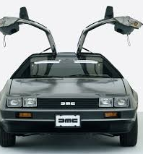
Time Travel in film
Without going online, make a list of as many movies as you can where time travel plays a part.

Slide 8
Did you come up with any of these films?
Bill and Ted;s Excellent Adventure
https://www.youtube.com/watch?v=q3fx6TugN7g
Back to the Future
https://www.youtube.com/watch?v=qvsgGtivCgs
Have a look online and read about the films to the right
X Men: Days of Future Past
Terminator (& sequels)
The Time Machine
Donnie Darko
Doctor Strange
Arrival
Interstellar
The Girl who Leapt Through Time
The Time Traveller's Wife
13 Going on 30
The Butterfly Effect

Slide 9
A quiz question for you...
When do you think the first popular novel involving time travel was written?
A. 1942
B. 1796
C. 1895
D. 1983
VOTE NOW!

Slide 10
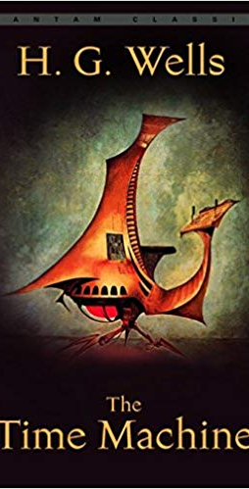
If you said '1895' then you were right!
It was written by HG Wells and was very popular at the time.
Here is a link to the beginning of the novel
https://www.penguinrandomhouse.ca/books/188557/the-time-machine-by-h-g-wells/9780375761188/excerpt
There have since been two movies made by Hollywood based on HG Wells' book.
Here's a trailer for the 1960 version
https://www.youtube.com/watch?v=36UQCZEsY9g

Slide 11
Why are we fascinated with ‘Time Travel’?
What do you think we find so interesting about time travel?
Before you read the article (link below) write down 3 reasons why
Use some of the films you thought of to help come up with your reasons
Why did you enjoy them?
Why did you choose to watch them?
Read the article below and see if you agree with any of the ideas discussed. Look up any words you do not know. There WiLL be some words you need to look up. Build your vocabulary!
https://www.nationalgeographic.com/news/2016/10/time-travel-history-science-james-gleick/

Slide 12
“Story is our only boat for sailing on the river of time.” – Ursula K. Le Guin
The above quote, taken from the article you have just read, is a great way of thinking about how different texts allow us to delve into the world of ‘Time Travel’
It is a beautiful metaphor comparing time to a river and stories to a boat. Why do you think this is appropriate?
Can you think of another metaphor ( a direct comparison) or a simile (a comparison using ‘like’ or ‘as’) to compare time to?

Slide 13
Now that we some knowledge and context about ‘Time Travel’ our task is: to explain how time travel impacts the plot, characters, and ending of a short story.
Learning Intentions:
Success Criteria:
To learn about how plot impacts characters
To develop your ability to recognise plot developments in stories
To develop your vocabulary when writing
To improve your proofreading skills
I have understood plot works in a story by writing a part of my essay on plot.
I have explained how key characters are impacted by time travel.
I have used excellent words within my writing that show my expanding vocabulary
I have read over my work at least twice to check for errors

Slide 14
Before you read ‘A Sound of Thunder’ remind yourself of these terms – you will have covered them last term when you studied a novel!
Plot Character
Setting Protagonist
Characterisation Symbol
Dialogue Theme
Conflict Antagonist
You should write down these terms and their meanings on paper or type them on a document. When you read the short story you’ll need to think about all of these. Hint: the ones underlined are very important. * check your answers against the sheet provided

Slide 15
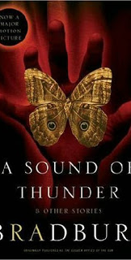
‘A Sound of Thunder’ by Ray Bradbury
You are going to read the above short story
It is about ‘Time Travel’ and the consequences it has on the future
Before you read it, write down 2 reasons wht time travel may not be a good thing
Keep your ideas safe and check them once you have finished
The next slide has some ‘active reading’ instructions.
This Photo by Unknown Author is licensed under CC BY-NC-ND

Slide 16
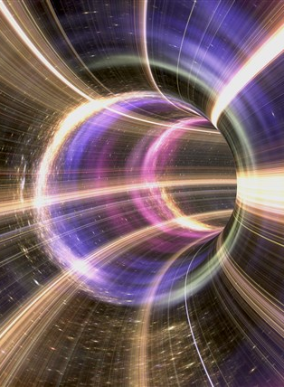
Looking at time travel in a text...
As you read, you should think about how this story involves elements like plot, characterisation, dialogue and time travel
Take notes as you read on the above terms (bullet points, mind map)
Look up any words that you do not know! This will build your vocabulary
The story is in the files provided by your teacher – take your time whilst reading and enjoy!

